Slide 1
Visual computing and mixed reality
Assignment 1
Shruthi Kura(101516439)
Naveena Katpally(101551664)

Slide 2
TASK 1
Write a MATLAB script which reads, converts a color image into grayscale image, and performs the histogram equalization on the grayscale one. Note that you are not allowed to use histeq, instead you have to implement a function to do histogram equalization. Do find some examples where histogram equalization achieves the worse results. Please discuss the pros and cons of histogram equalization method.
Histogram
Histogram is an graphical representation of numerical data of the image.
Bars in histogram gives information about the contrast of the image.
If we stretch the histogram the image looks more brightened and sharpened.

Slide 3
Histogram equalization
It transform the intensity values so that the histogram of the output image approximately matches the flat histogram.
It is used to enhance the contrast of the image.
It may not increase the contrast in every case.
In this the gray level values are may or may not be same as that of the input histogram image
Histogram equalization can be obtained by finding
1)Probability function of the image
2)Cumulative distribution of the image
3)Multiplying cumulative distribution values with (graylevel-1) values
4) Round off to near values.

Slide 4
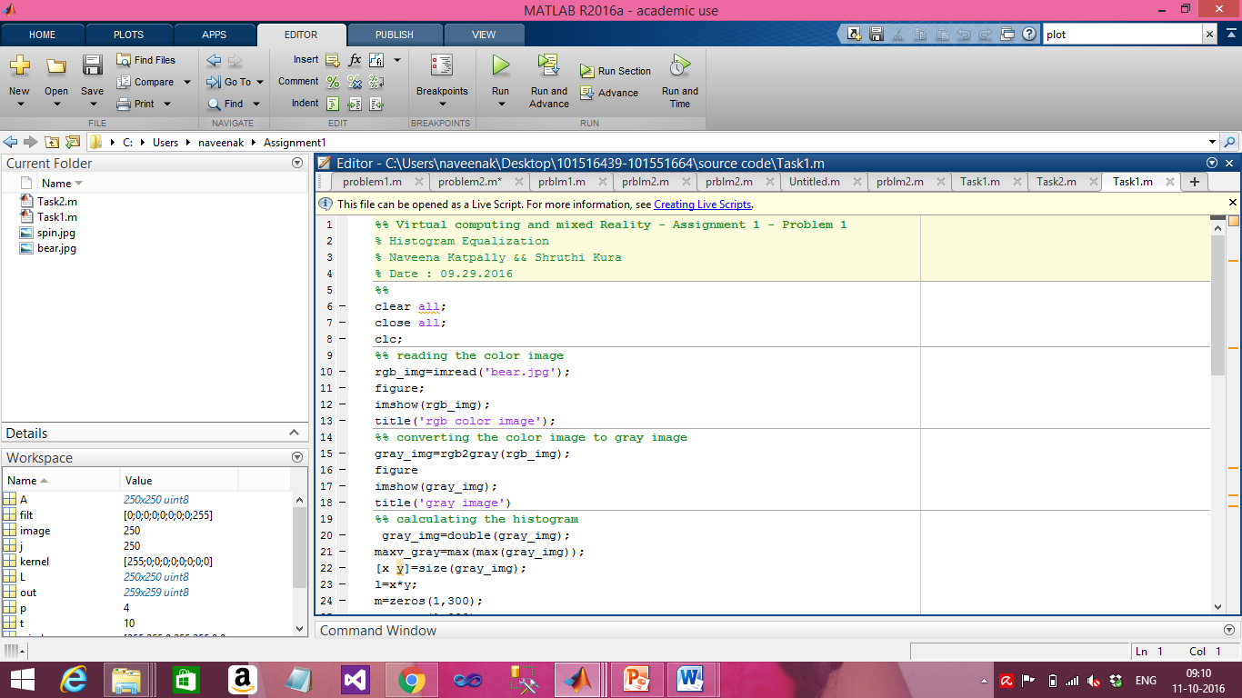

Slide 5
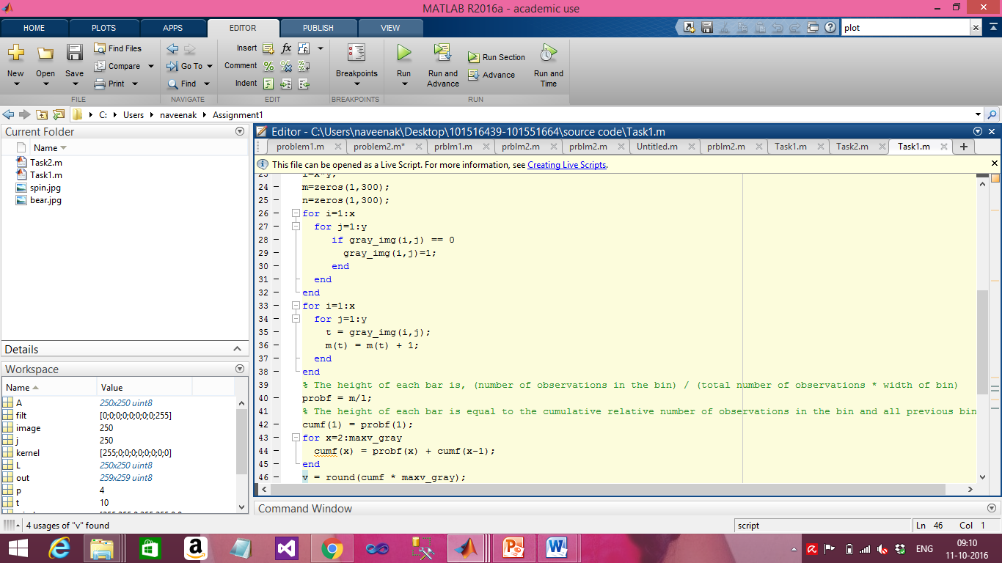

Slide 6
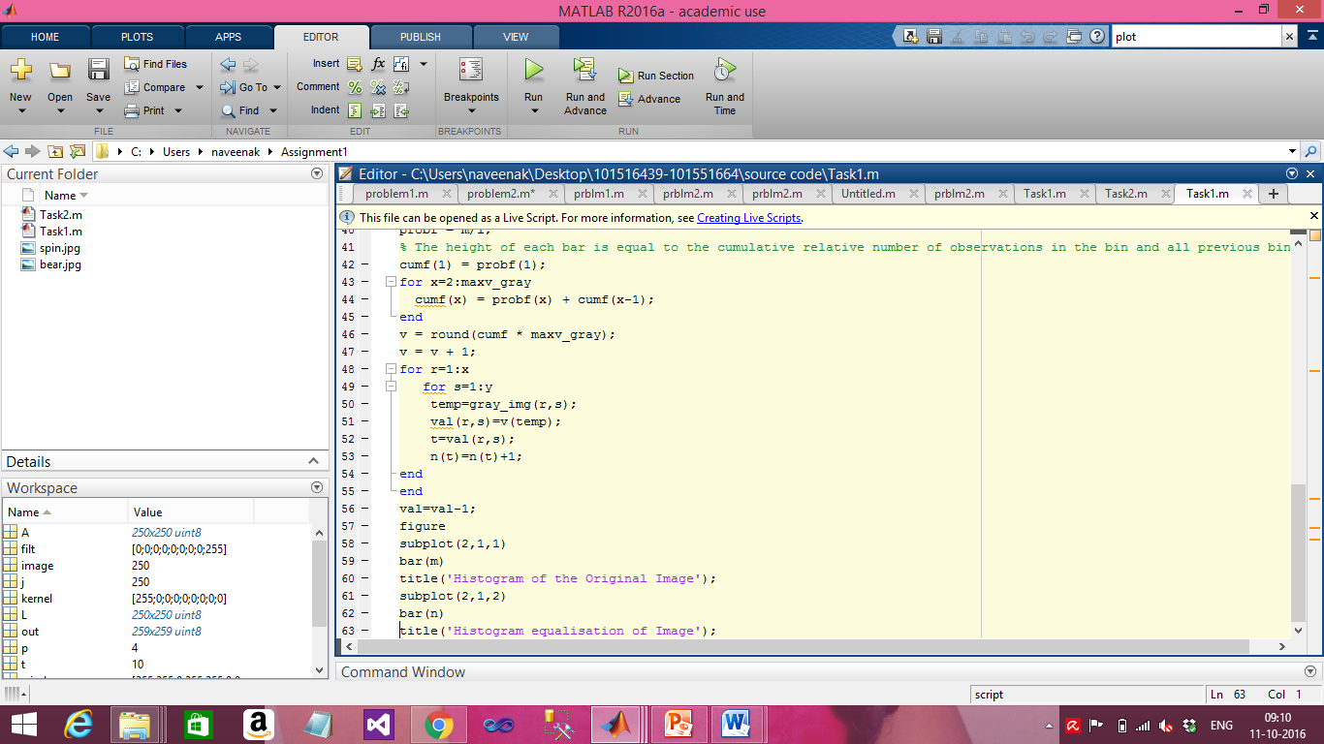

Slide 7
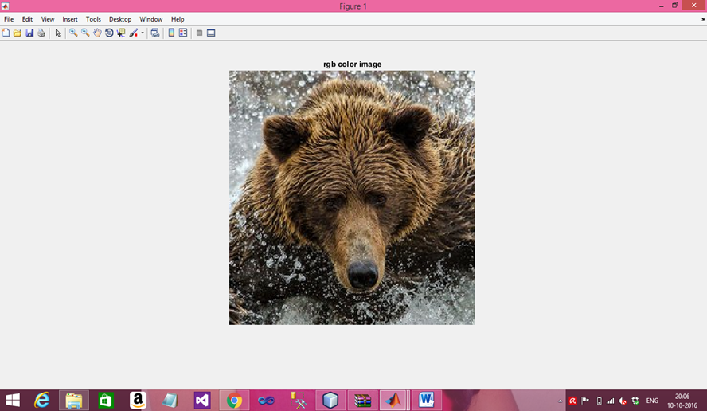
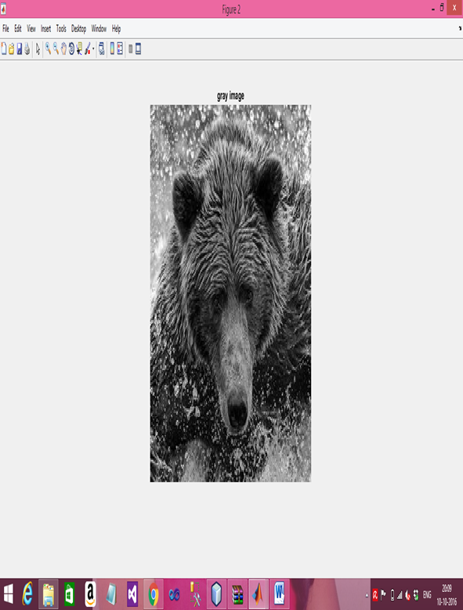
Output
Figure 2: gray scale image
Figure 1: original image

Slide 8
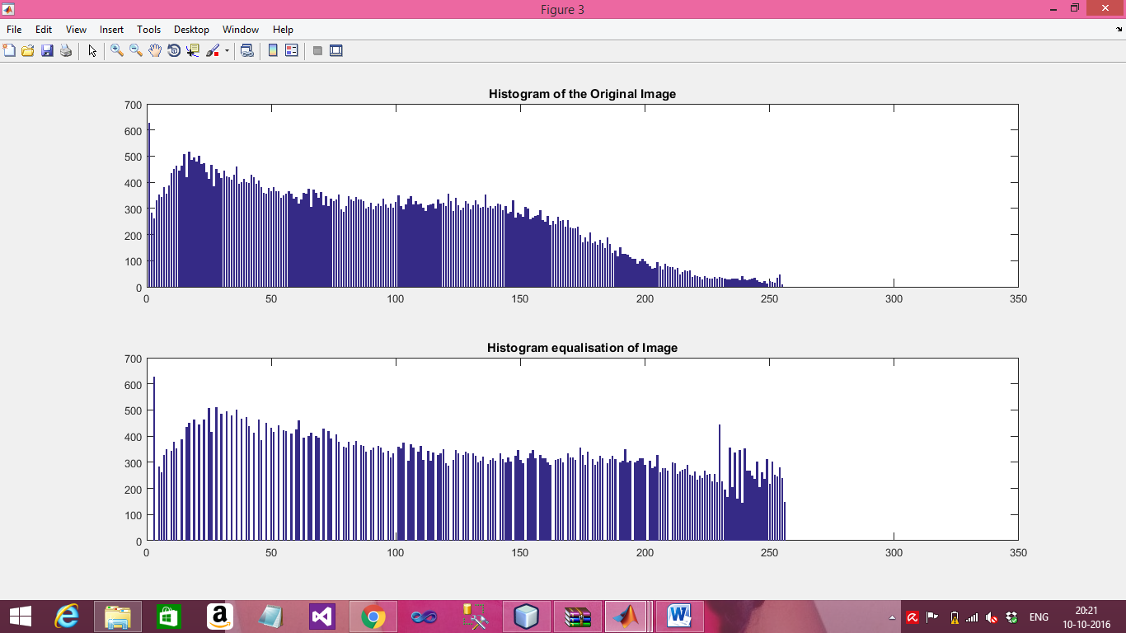
Figure 3: Histograms diagram

Slide 9
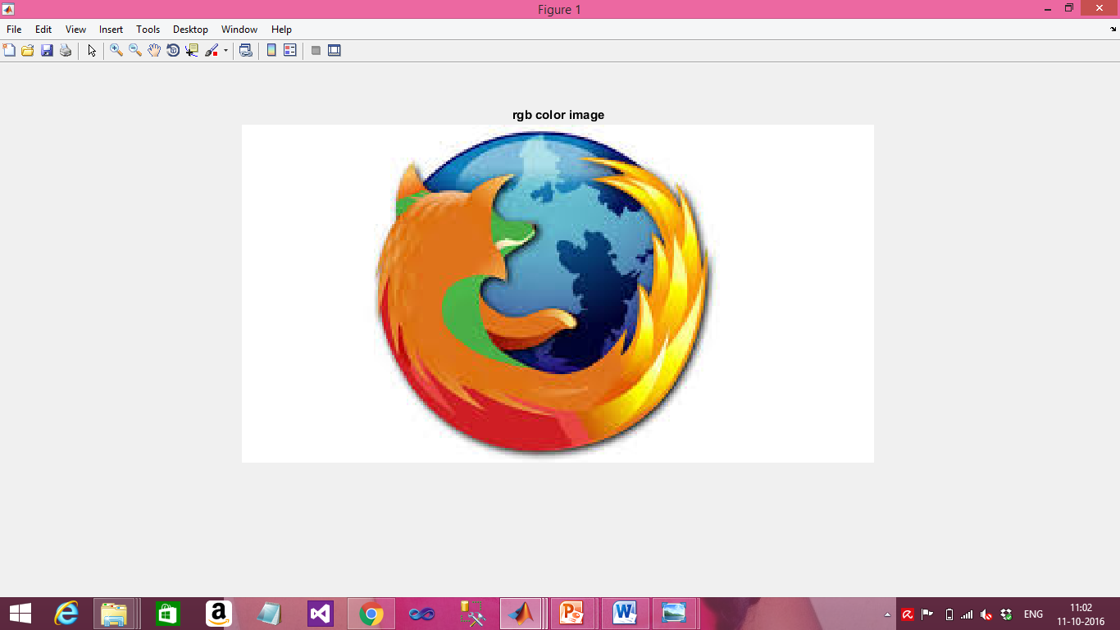
Histogram Equalization does not supports for all the images. In some cases it makes a slight change.
Example:
Original image

Slide 10
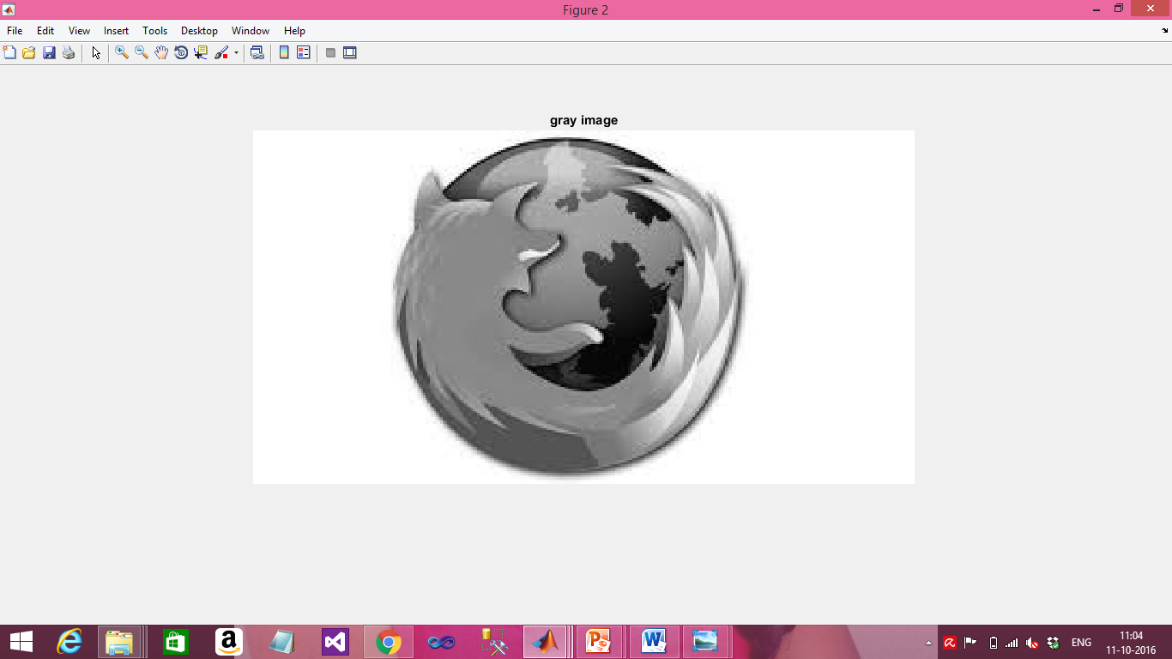

Slide 11
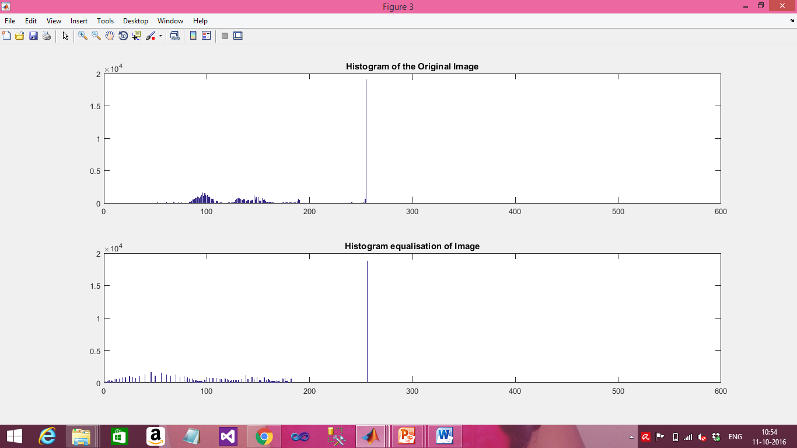
Histogram Equalization does not supports for all the images. In some cases it makes a slight change.

Slide 12
Image Filtering
Image Filtering is a technique for modifying or enhancing an image.
Image processing operations are implemented with filtering includes smoothing, sharpening and edge enhancement.
Filtering is an neighbourhood operation, in which the value of any given pixel in the output image is determined by applying some algorithm to the values of pixel in the neighbourhood of corresponding input pixels.
Min, Max and Median are non linear filters ,they are used for denoising.
Median Filter: it eliminates slight noise, preserve the edges and avoid excessive smoothening.
Min Filter : Min filter replaces the dark value in central pixel of a window. In this Background is viewed.
Max filter : Max filter is used to find the brightest points in an image, and gives the maximum value of the window, In this foreground is viewed.

Slide 13
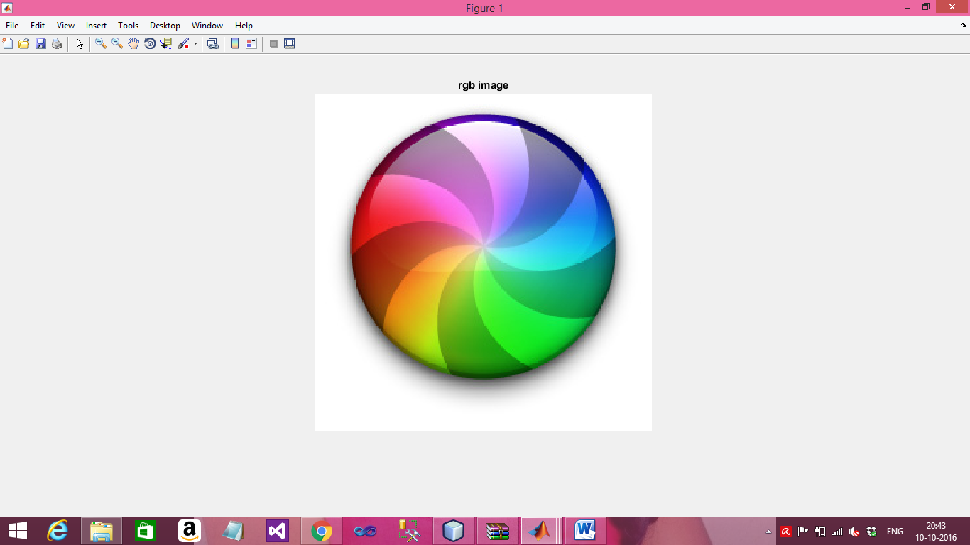
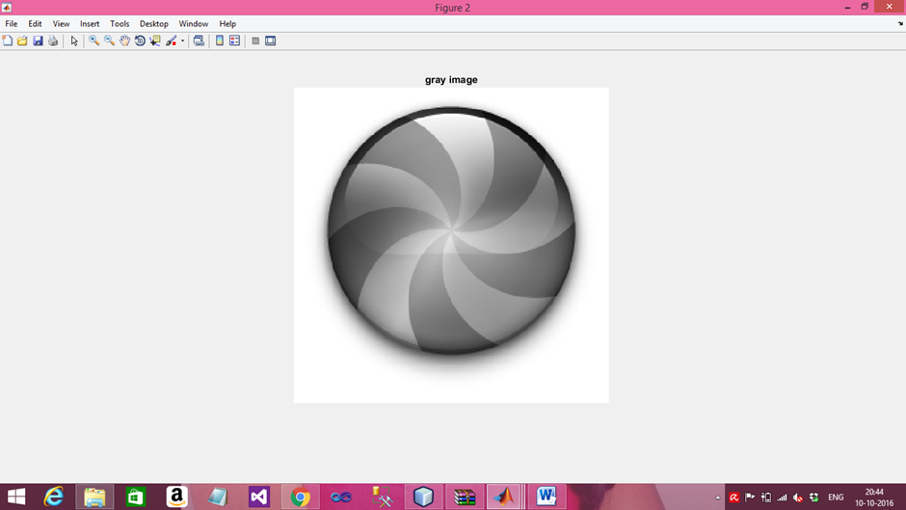
Input image:

Slide 14

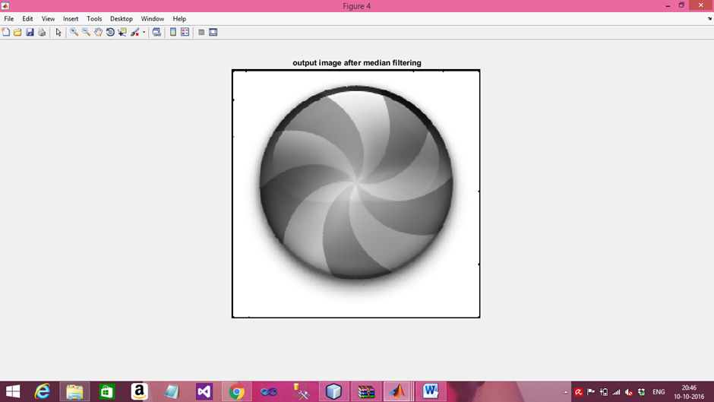
Applying noise to the image:
image=imnoise(image,'salt & pepper',0.05);
Denoise image or median image

Slide 15
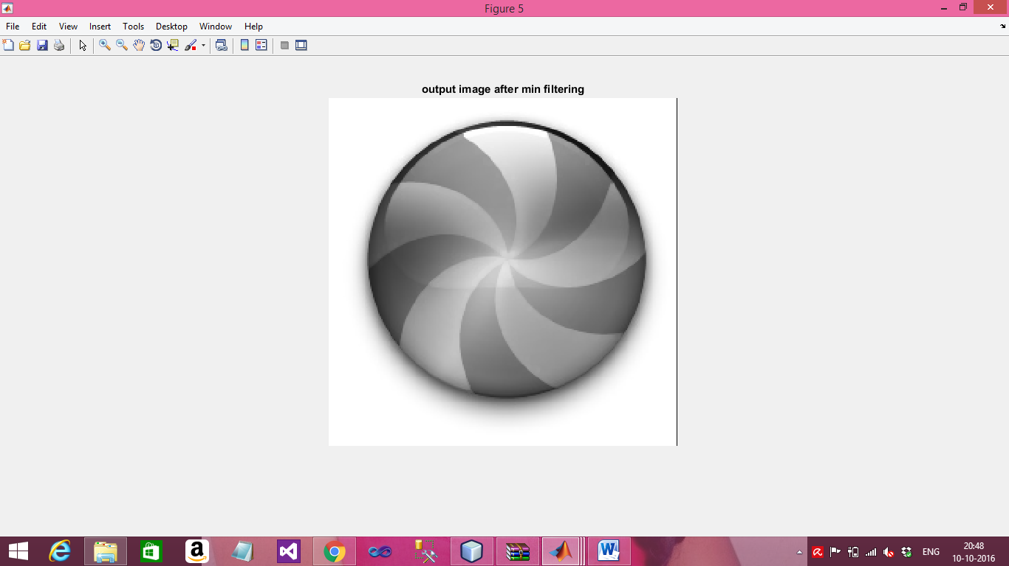
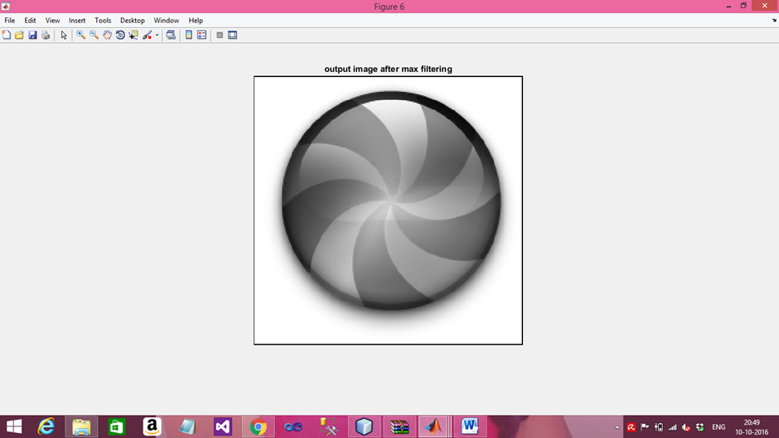
Image after applying Min filter
Image after applying Max filter

